Slide 1
Data Science Training Trees, Bagging and Random Forest
Nov 7th 2016

Slide 2
Machine Learning
Today we expand on trees.
Trees is a non-parametric method, as opposed to regression, ridge, lasoo which are parametric methods. They assume a form to the data, trees do not assume any form, so is good for complex shapes.
Random forest is called an ensemble method. It creates a lot of different trees and averages the results.
It is rather unituintive, but true, that when you make lots of very silly trees, or weak learners, and add them together; it works better than combining strong trees. Today we learn how to make silly trees ☺ those weak learners.
See the book on Box or free online An Introduction to Statistical Learning, with Applications in R. Gareth James, Daniela Witten, Trevor Hastie and Robert Tibshirani

Slide 3
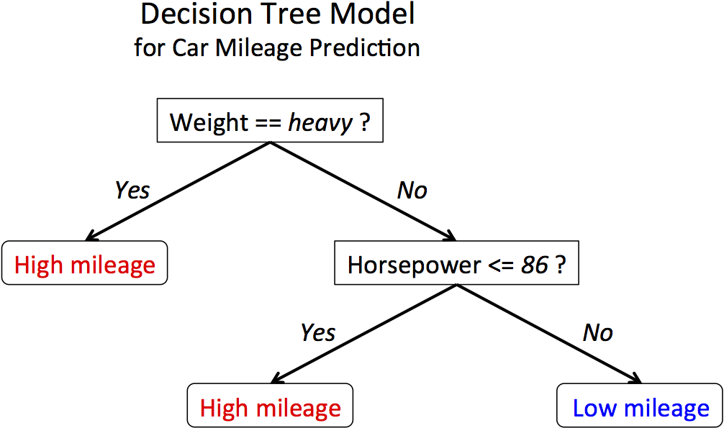
The basics

Slide 4
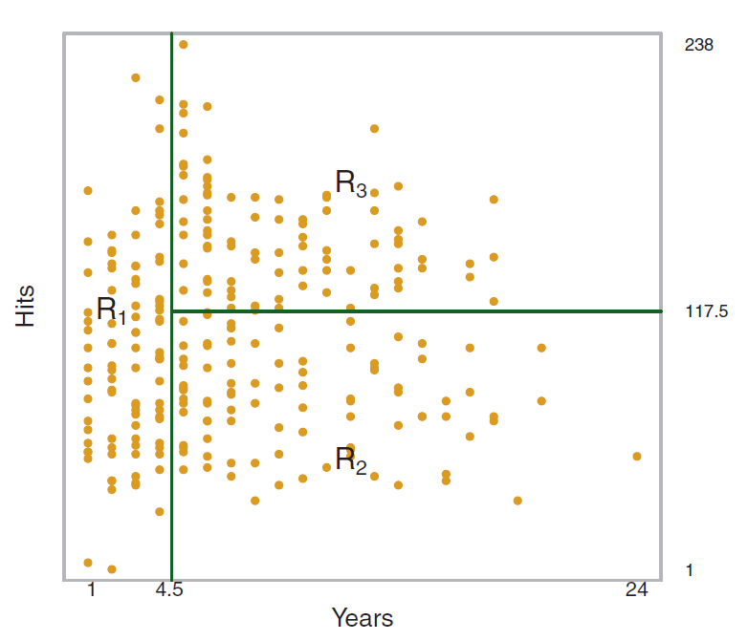
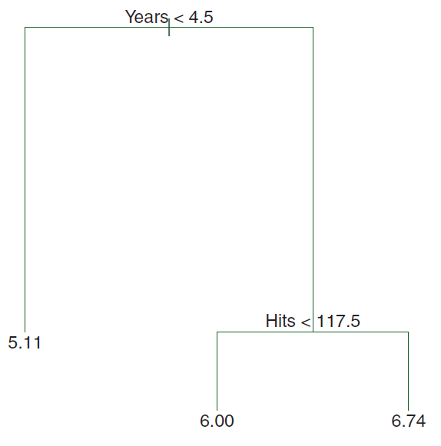
Trees
Predict Salary in Hitters Data
Salary
Blue – avg left is 4 salary ; avg on right is 7 salary - RMSE 4.5
Green – avg left is 4.8 salary ; avg on right is 6.5 salary - RMSE 3.8
Red – avg left is 5 salary ; avg on right is 6 salary - RMSE 4.9

Slide 5
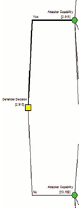
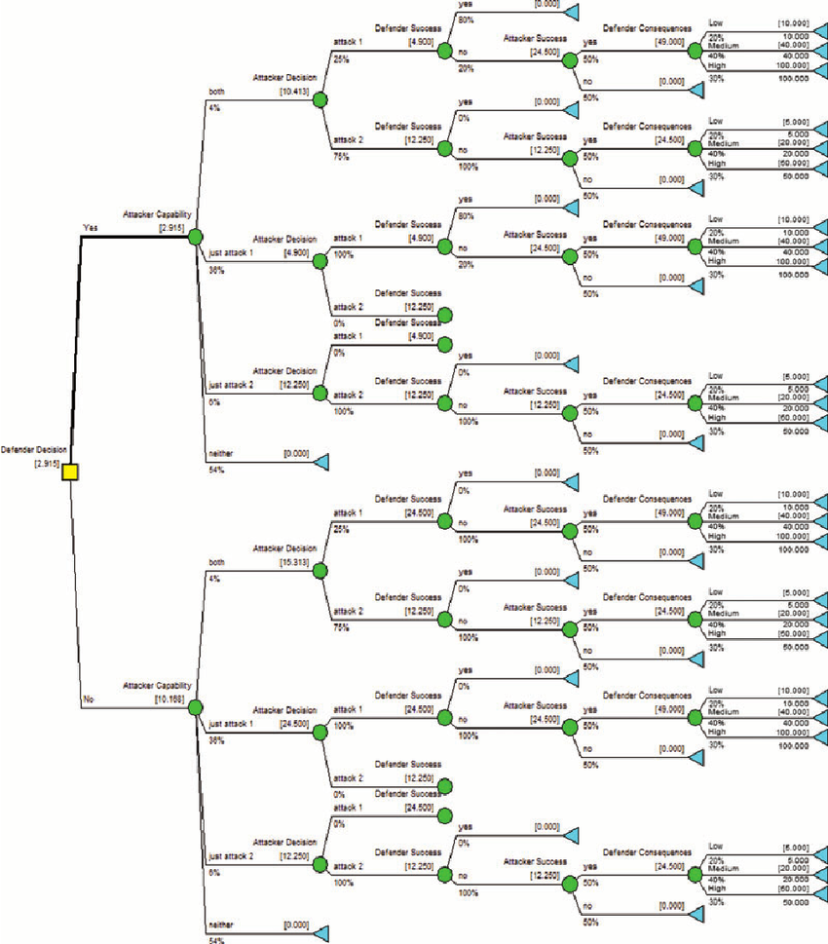
Weak Learners
Weak Learner – Really Bad Prediction
Strong Learner – Good Prediction
Constrain on,
- allowed depth
- number of variables which can be used
- number of leaves
- minimum node size
- only using a subset of rows
Use all data; grow deep.

Slide 6
Ensemble of Weak Decision Trees
“Random Forest”
All Data Variables
Notes:
An ensemble of trees brings many weak learners together to make a stronger single learner.
So each one of these trees is very short, and it only uses a small subset of the variables.
Example….

Slide 7
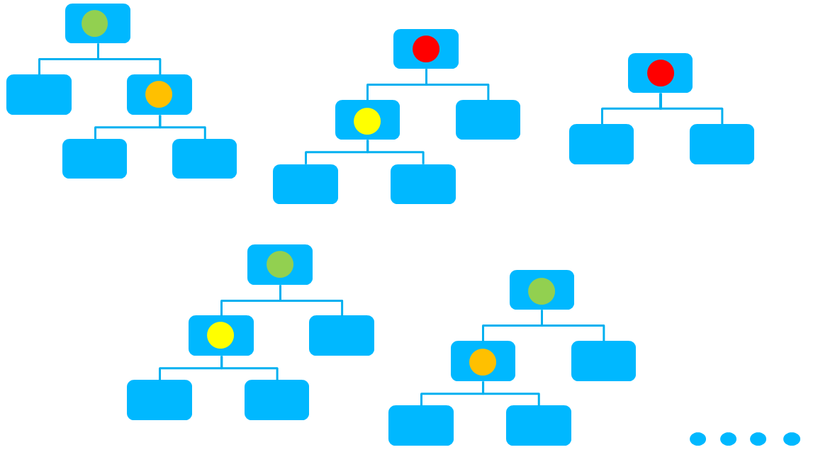
Ensemble of Weak Decision Trees
“Random Forest”
All Data Variables
Average prediction of all trees to make one prediction
Notes:
An ensemble of trees brings many weak learners together to make a stronger single learner.
So each one of these trees is very short, and it only uses a small subset of the variables.
Example….

Slide 8
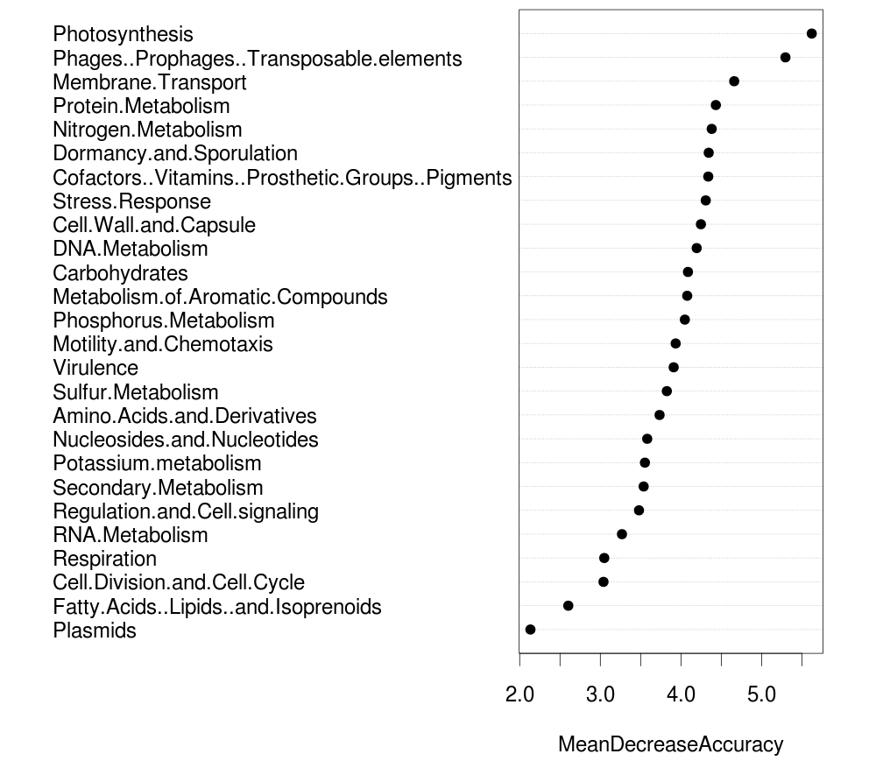
Feature Importance

Slide 9
Thank you!

